Slide 1

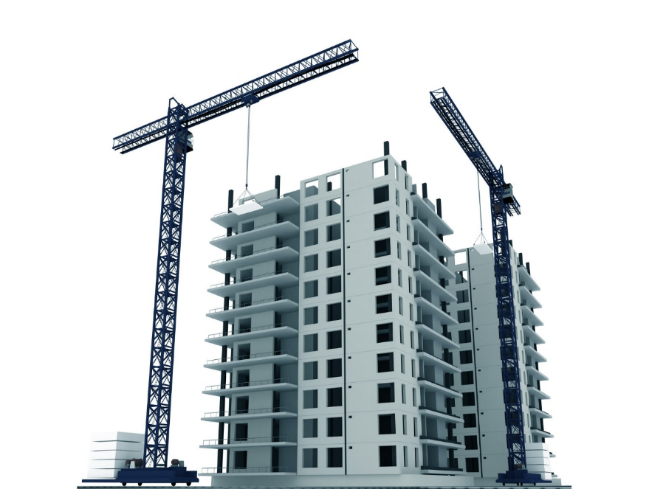
HI-TECH PROJECTS PVT. LTD.
PROJECT REVIEW MEETING
PROJECT NAME: TORRENT POWER, NARANPURA
PRESENTED BY:
TPNA Team

Slide 2
PROJECT DETAILS
Project | Torrent Power, Naranpura
Client | Torrent Power
Architect | Munjal Bhatt
Structural Consultant | Ducon Consultant Pvt. Ltd.
Consultant | TUV Nord
Tender Cost (in lacs) | 2716.72
Tentative Project Cost (in lacs) | 5500
Start Date (As per PO) | 09/08/2018
Finish Date (As per PO) | 30/10/2022
Actual Start Date | 15/09/2018
Finish Date (As per Bar Chart) | 31/12/2022
Lapsed Vs Total Duration in days | 1257/1569 Days
Project plan Vs Achievement (in lacs) | 3807/3508.03 lacs = 108.52%
Billing Till Last Month (in lacs) | 3807 lacs
PROJECT REVIEW MEETING JAN'22

Slide 3


REVIEW OF LAST MOM
MOM - PROJECT REVIEW MEETING
SITE |  | TPNA | Date | 28/12/2021
Sr. | Agenda Points | Key Measurable / Action to be Taken | Responsible Person | Target Date | Progress Status | Action Taken
1 | Flooring Material | Check data of site infra flooring material. Seems too high in CCR report. | Dipal Patel, Sagar Lodaya, Dhruvil Raval | 31/12/2021 | Done | New labour colony Cement fibre sheet amount of 3.58 lacs.
2 | Machine hiring | Check machine hiring charges on site. Seems too high in CCR report. | Dipal Patel, Sagar Lodaya, Dhruvil Raval | 31/12/2021 | Done | Reduced hiring charges from Nov’21 – 70k to Dec’21 – 48k and in Jan’22 – 26k
3 | PRM Presentation | Add a slide about reason of variance for feasibility vs. achievement. | Dipal Patel, Sagar Lodaya, Dhruvil Raval | 13/01/2022 | Done | Incorporated in slide
4 | Sparing in ERP | Spare the extra material/asset from ERP little in advance to enable more effective material/asset management. | Dipal Patel, Sagar Lodaya, Dhruvil Raval | 29/12/2021 | Done | Balance shuttering material identified
5 | Store | At the end of the month, run closing stock report in ERP and check with physical stock on site with the help of store in-charge for more accurate data. Make it a practice. | Dipal Patel, Sagar Lodaya, Dhruvil Raval | 31/12/2021 | In Progress | In Progress
PROJECT REVIEW MEETING JAN'22

Slide 4
PLAN V/S ACTUAL
Project Value | For the month of January’22 |  |  |  | Cumulative for the Project up January’22
 | Sales as per Bar chart | Sales as per Feasibility | Sales (Client Bill) | % Achievement | Cumulative Sales as per Bar chart | Cumulative (Client Bill + WIP) Sales | % Achievement wrt Bar chart
A | B | C | D | E = D/C | F | G | H = G/F
5500 | 111.69 | 100.64 | 154 (81+63+10) (Payable + Exhausted + Extra item) | 153.02% | 3508.03 | 3807 | 108.52%
Note: All figures are in Lacs
PROJECT REVIEW MEETING JAN'22

Slide 5
REASON OF VARIANCE
Sr. No. | Description | Unit | Feasibility Plan |  | Achievement |  | Remarks
 |  |  | Qty | Amount (lacs) | Qty | Amount(lacs)
1 | Reinforcement | MT | 67.58 | 43.54 | 74.91 | 48.26 | 6FRS Pour 2, 7FRS Pour 1 & 2, 4FRS Pour 4
2 | Shuttering | Sqm | 1883.18 | 17.49 | 2434.89 | 21.85 | 6FRS Pour 2, 7FRS Pour 1 & 2, 4FRS Pour 4, GF to 4F Lintel
3 | Concrete | Cum | 356.90 | 21.03 | 410.48 | 23.91 | 6FRS Pour 2, 7FRS Pour 1 & 2, 4FRS Pour 4
4 | Blockwork | Cum | 217.10 | 11.25 | 546.26 | 28.72 | 2nd,3rd,4th Floor
5 | Plaster | Sqm | 1632 | 5.58 | 2186 | 7.47 | GF & 1st Floor
6 | Other |  |  | 1.74 |  | 24.7 | Extra Item – 10.01 Lacs
Total |  |  |  | 100.63 |  | 154.84
PROJECT REVIEW MEETING JAN'22

Slide 6
NEXT QUARTER PLAN
Project Value (in lacs) | Cumulative Bill Achieved up to previous month | % Completed | Next Quarter Plan (in lacs) |  |  | Quarter's Target | Balance Amount | Remarks
 |  |  | Feb-22 | Mar-22 | Apr-22
A | B | C = B/A | D | E | F | G = D+E+F | H = A - (B+G)
5500 | 3807 | 69.22% | 98.05 | 125 | 124 | 347.05 | 1345.95 | As per last budget
Note: All figures are in Lacs
PROJECT REVIEW MEETING JAN'22

Slide 7
MANPOWER STATUS
Group Name | Manpower Requirement for Feb’22 |  |  | Total Available in Feb’22 | Shortfall
 | Skilled | Unskilled | Total
A | B | C | D=B+C | E | F=D-E
Reinforcement | 13 | 13 | 26 | 15 | 11
Formwork | 15 | 15 | 30 | 26 | 4
Post Tension | 1 | 1 | 2 | 0 | 2
Rebar | 1 | 0 | 1 | 1 | 0
Unskilled | 4 | 30 | 34 | 27 | 7
Hacking Work | 0 | 2 | 2 | 0 | 2
Painting | 2 | 2 | 4 | 6 | -2
Rendering | 1 | 1 | 2 | 0 | 2
Trimix Work | 0 | 0 | 0 | 0 | 0
Flooring Work | 2 | 2 | 4 | 9 | -5
PROJECT REVIEW MEETING JAN'22

Slide 8
MANPOWER STATUS
Group Name | Manpower Requirement for Feb’22 |  |  | Total Available in Feb’22 | Shortfall
 | Skilled | Unskilled | Total
A | B | C | D=B+C | E | F=D-E
Waterproofing Work | 1 | 1 | 2 | 0 | 2
Fabrication Work | 0 | 0 | 0 | 0 | 0
False Ceiling Work | 0 | 0 | 0 | 0 | 0
Masonry & Plaster Work | 15 | 22 | 37 | 39 | -2
POP Punning | 2 | 3 | 5 | 5 | 0
Doors and Window | 0 | 0 | 0 | 0 | 0
Plumbing | 2 | 2 | 4 | 2 | 2
Total Manpower | 59 | 94 | 153 | 130 | 23
PROJECT REVIEW MEETING JAN'22

Slide 9
LAST 3 MONTH VALUATION
Category Name | Nov-21 | Dec-21 | Jan-22
Consumable Asset | 10.43 | 10.64 | 10.55
Material | 36.37 | 34.19 | 55.97
Oil & Fuel | 0.23 | 0.23 | 0.40
Sparepart | 0.98 | 0.97 | 0.95
Total | 48.01 | 46.03 | 67.87
Note: All figures are in Lacs
PROJECT REVIEW MEETING JAN'22

Slide 10
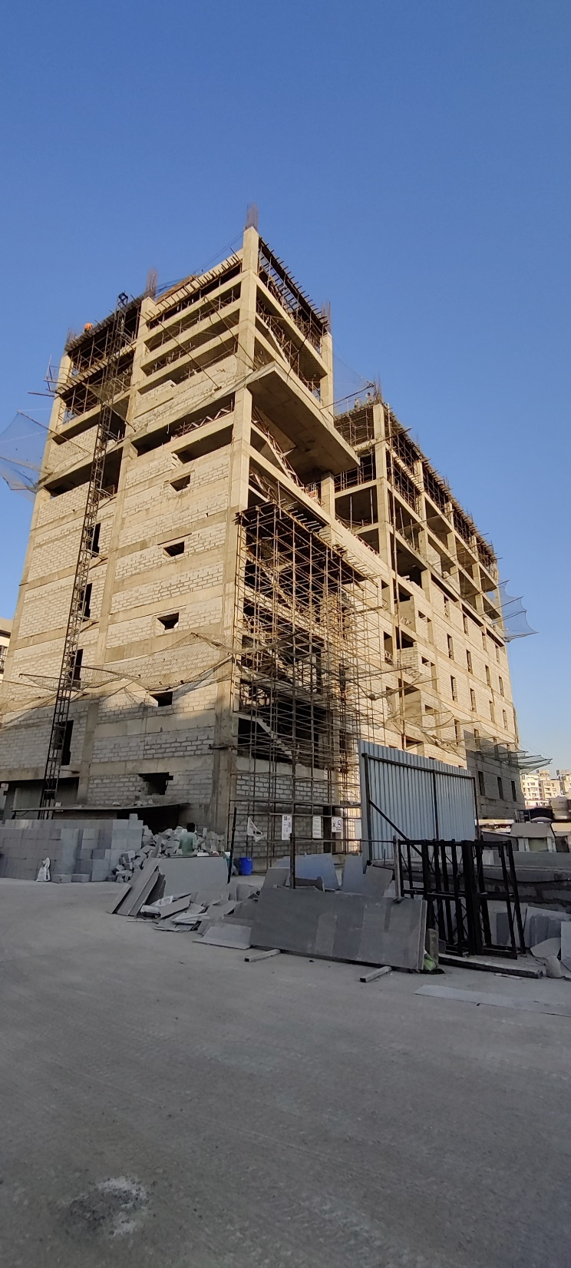
PROJECT CURRENT STATUS PHOTOS
PSC Building
PROJECT REVIEW MEETING JAN'22

Slide 11
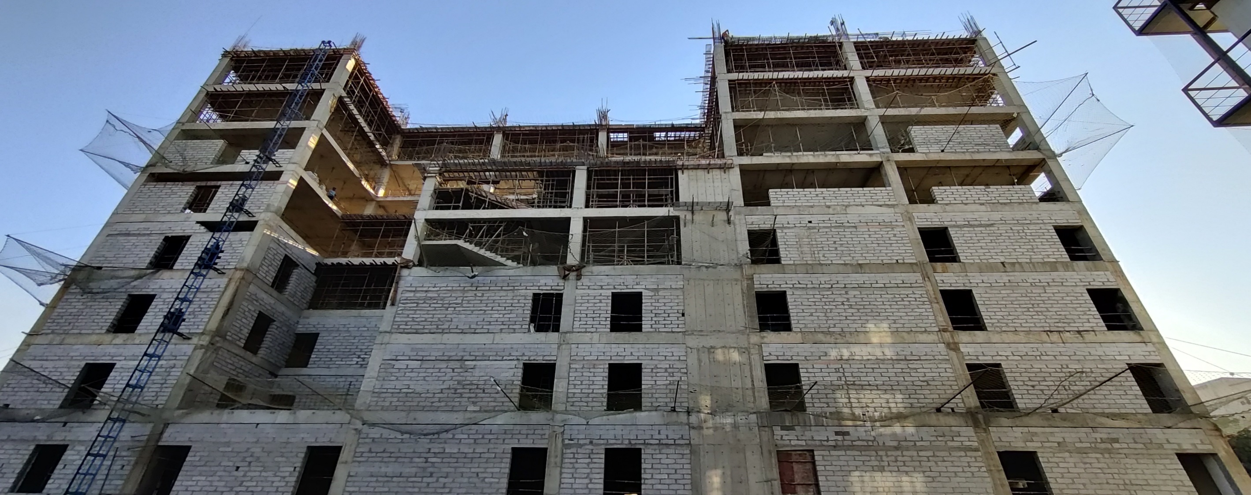
PROJECT CURRENT STATUS PHOTOS
PSC Building
PROJECT REVIEW MEETING JAN'22

Slide 12
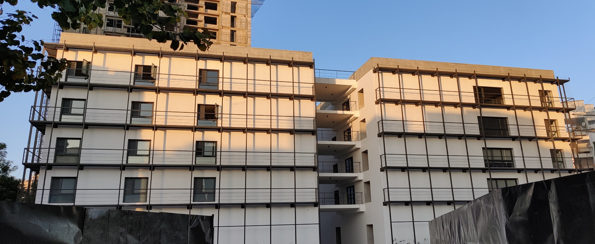
PROJECT CURRENT STATUS PHOTOS
MTL Building
PROJECT REVIEW MEETING JAN'22

Slide 13
PSC BUILDING - PICTORIAL PROGRESS
10th
9th
8th
7th
Pour 2 – 8FRS - Slab R/F in Progress
Pour 3 – 5FRS -Slab completed
6th
Legends
Slab Work Balance
Slab in progress
Slab Completed
B/W & Plaster WIP
POP Punning WIP
POP Punning Completed
5th
4th
3rd
Pour 1 – 8FRS - Slab R/F in progress
2nd
1st
GF
PSC Building Progress status – 15.02.22
PSC Building Plan Area
PROJECT REVIEW MEETING JAN'22

Slide 14
SUPPORT FROM HEAD OFFICE
PROJECT REVIEW MEETING JAN'22

